Slide 1

Lecture # 03
From prose to Z - progression from informal to formal descriptions

Slide 2
Components of Formal Specification
A specification is formal if it is expressed in a language made of three components:
i. Syntax
rules for determining the grammatical well-formedness of sentences
ii. Semantics
rules for interpreting sentences in a precise, meaningful way within the domain considered.
iii. Proof theory
rules for inferring useful information from the specification .
This component provides the basis for automated analysis of the specification.

Slide 3
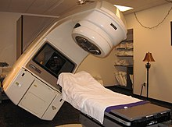
Therapy control console- Informal requirements
A purpose of control program for the therapist's console, on a radiation therapy machine, is to help ensure that patients are treated correctly, as directed by their prescriptions.
The console program ensures that the radiation beam can only turn on when the correct settings have been achieved.

Slide 4
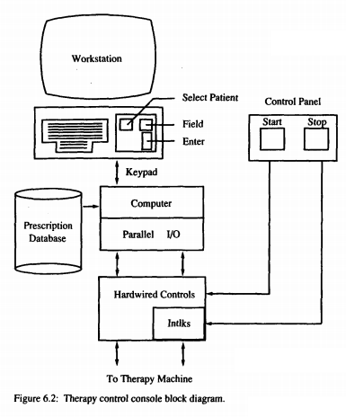
Therapy control console - Informal requirements
The treatment console computer stores a database of prescriptions for many patients. Each patient's prescription usually includes several different beam configurations called fields. Each field is defined by many machine settings
The therapist operates the control program at an ordinary workstation, selecting different console operations by pressing labeled function keys (Figure 6.2)
The therapist actually turns the radiation beam on and off by pressing buttons on a separate control panel. These buttons act on directly the therapy machine through nonprogrammable hard-wired controls.

Slide 5
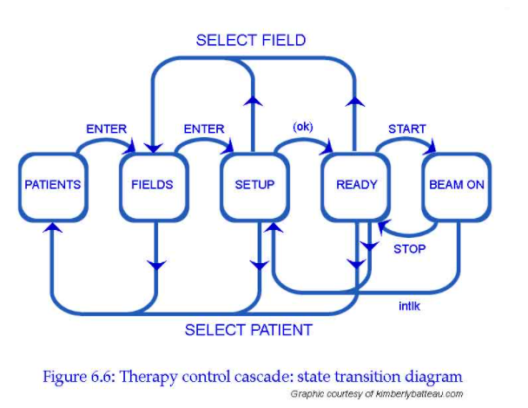
Therapy control console - State transition diagram
We can draw a state transition diagram.
States are indicated by bubbles
Transitions between states by arrows.
The arrows are labeled with the events that cause state transitions.
Thus, in the PATIENTS state pressing the ENTER key causes a transition to the FIELDS state, but in the FIELDS state pressing ENTER gets you to SETUP.
We can trace all possible treatment sequences by following the arrows around the diagram.

Slide 6
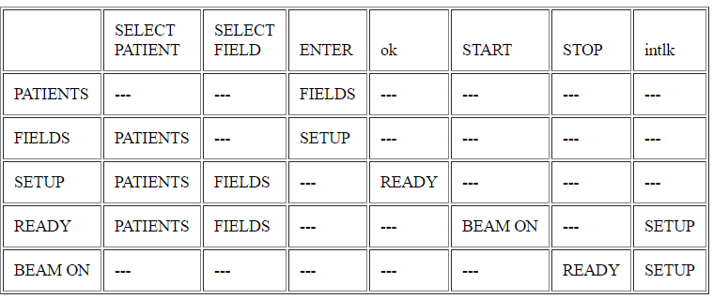
State transition table
Therapy control console - State transition table
The state transition diagram is a picture of our state machine model.
Here is the state transition table.
Entries in the table indicate the next state that is reached when the event indicated by the column heading occurs during the state indicated by the row heading.
This table is a bit more explicit than the state transition diagram because it makes it clear when events are ignored.
For example, pressing the SELECT PATIENT key in the BEAM ON mode has no effect (causes no state change); this is indicated by the hyphen --- in the table.
Including all of these in the diagram would make it too cluttered.
As notations grow more formal, they become more explicit and rely less on unwritten assumptions.

Slide 7
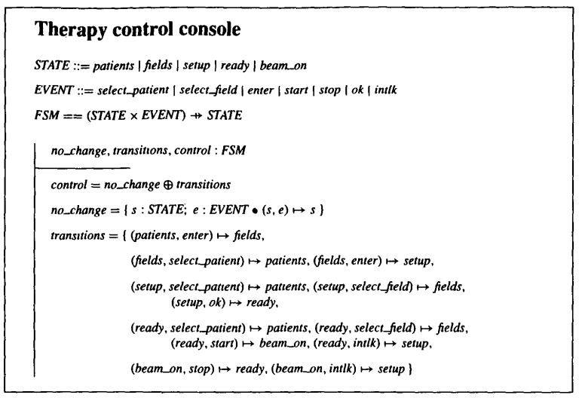
Therapy control console – Z
Finally, we express the state machine model in Z.
Don't worry about the details of the notation for now.
This example already illustrates two of the most powerful concepts in formal methods: using compact symbolic expressions to represent lots of cases in a little space, and using operators to build up complex formulas from simpler ones.

Slide 8
Therapy control console – Z
For example, the expression (patients,enter) ↦ fields corresponds to the single transition in the first row of the table: when the patients screen is displayed, pressing enter displays the fields screen.
Likewise, (fields, select_patient) ↦ patients,(fields, enter) ↦ setup represents the two transitions in the second row of the table..
This is the most explicit version yet.
State transition tables are often very sparse: most of the entries are empty "nothing changes" cells that make the tables large and difficult to read.

Slide 9
Therapy control console – Z
In Z we don't have to enumerate all the no_change transitions as we did in the table --- we can do it symbolically;
no_change is actually a state machine that does nothing.
We define a second machine, transitions, that includes only the transitions where something actually happens.
Then we use the Z override operator ⊕ to combine the two. The expression no_change ⊕ transitions describes the state machine that behaves as no_change, except when there is a relevant entry in transitions.

Slide 10
What is Z?
Z (pronounced zed) is a set of conventions for presenting mathematical text, chosen to make it convenient to use simple mathematics to describe computing systems.
I say computing systems because Z has been used to model hardware as well as software.

